Slide 1
Chiba Campaign Daily Report
2022 12/5
B3 Shunya Mizobuchi
Notes:
顧さんは？
1

Slide 2
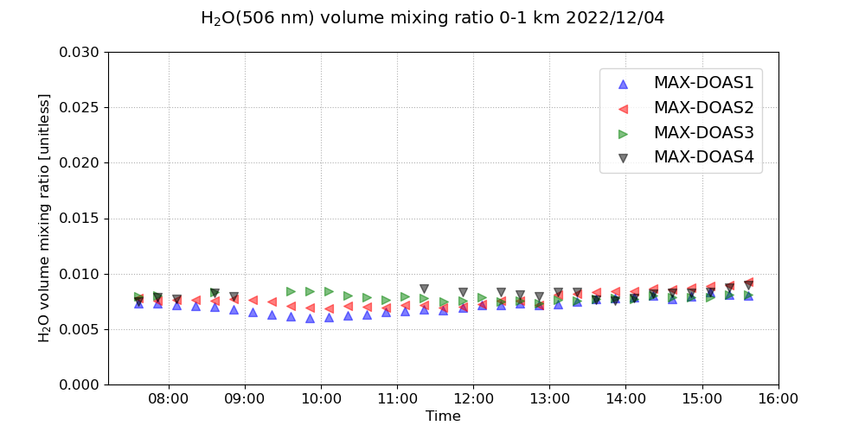
H₂O volume mixing ratio(4 Directions)

Slide 3
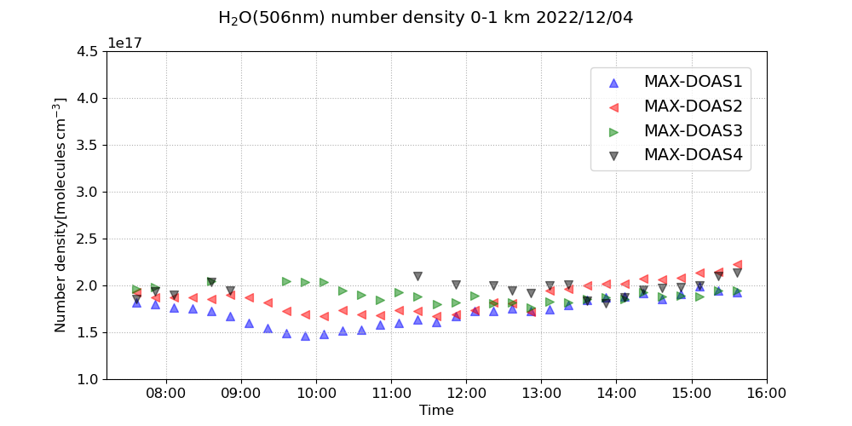
H₂O number density(4 Directions)

Slide 4
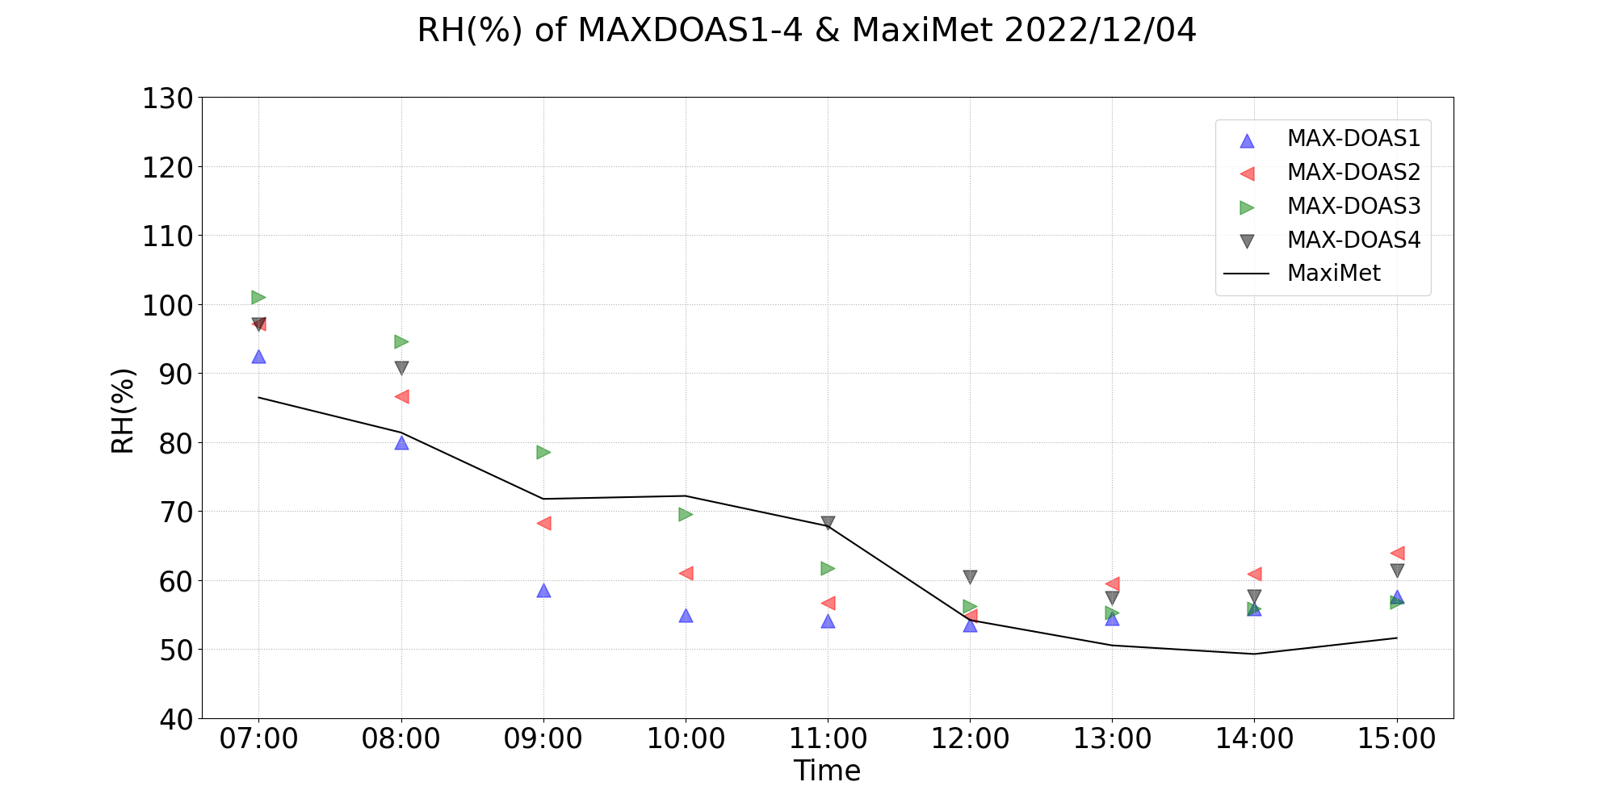
Comparison of RH between MAX-DOAS and Maximet

Slide 5
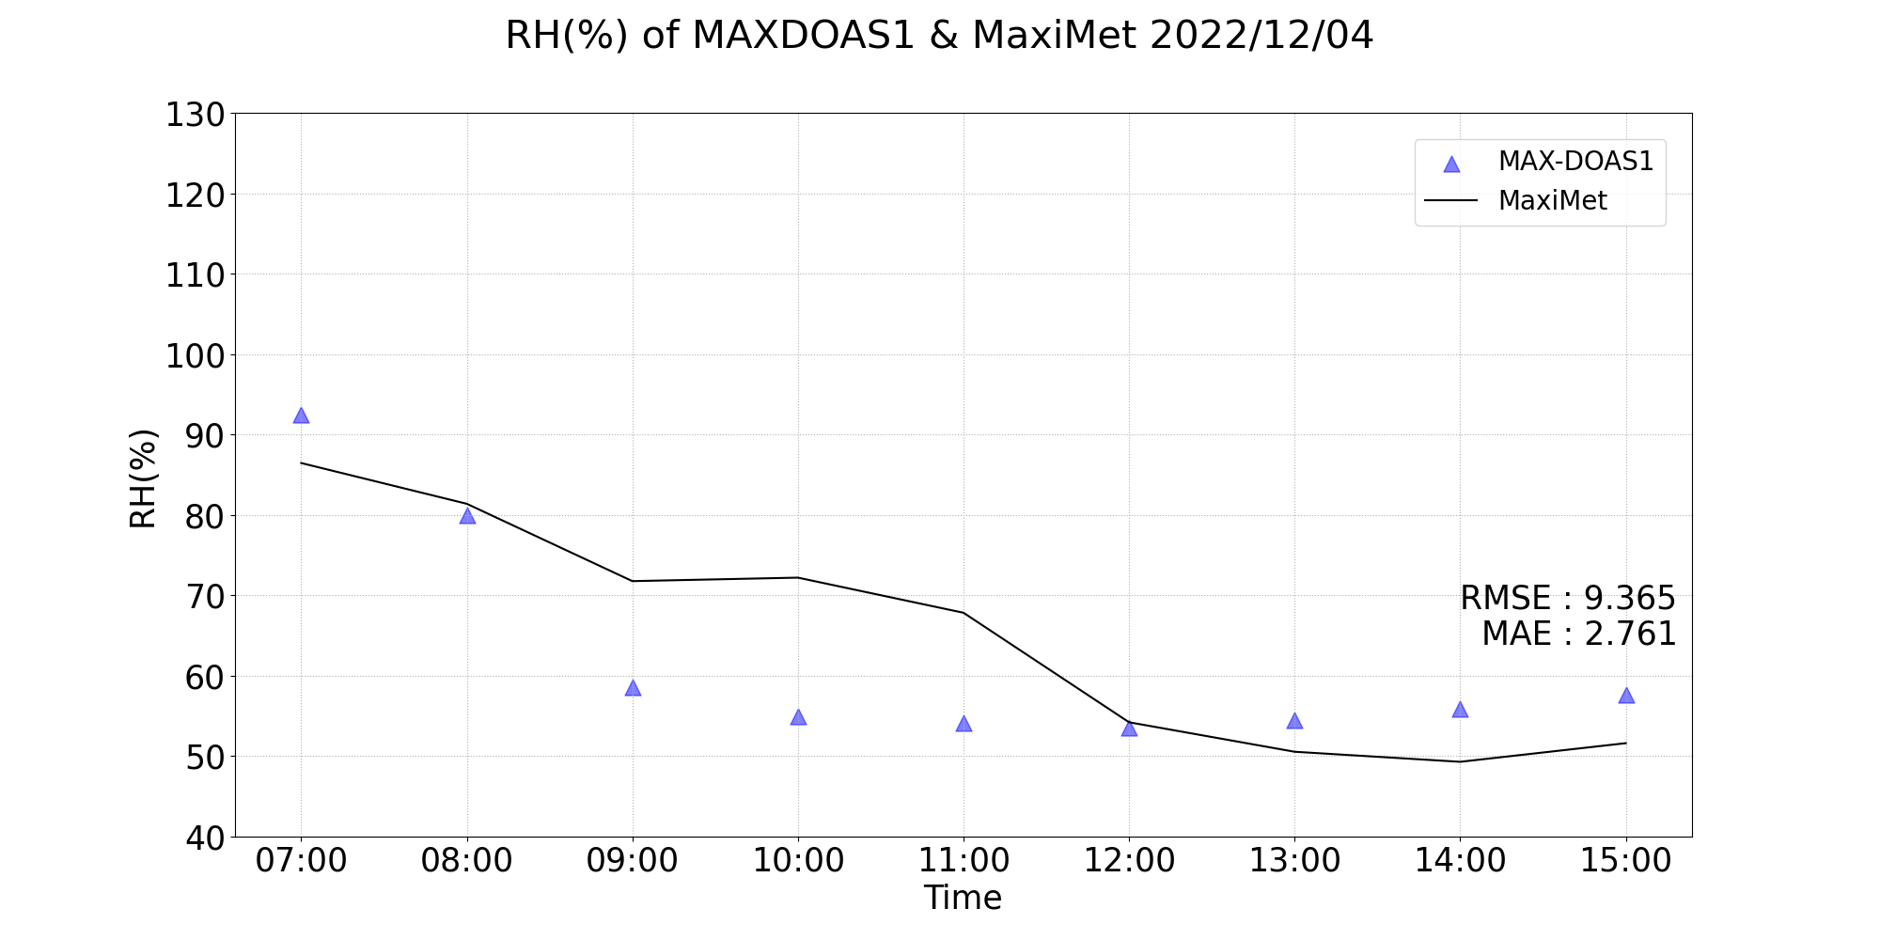
RMSE and MAE of RH(%)

Slide 6
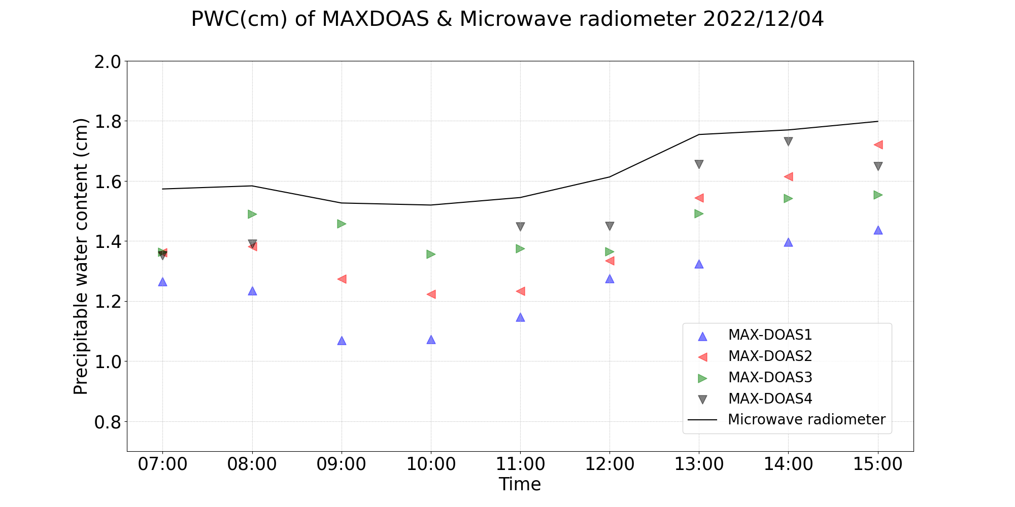
Comparison of PWC between MAX-DOAS and MWR

Slide 7
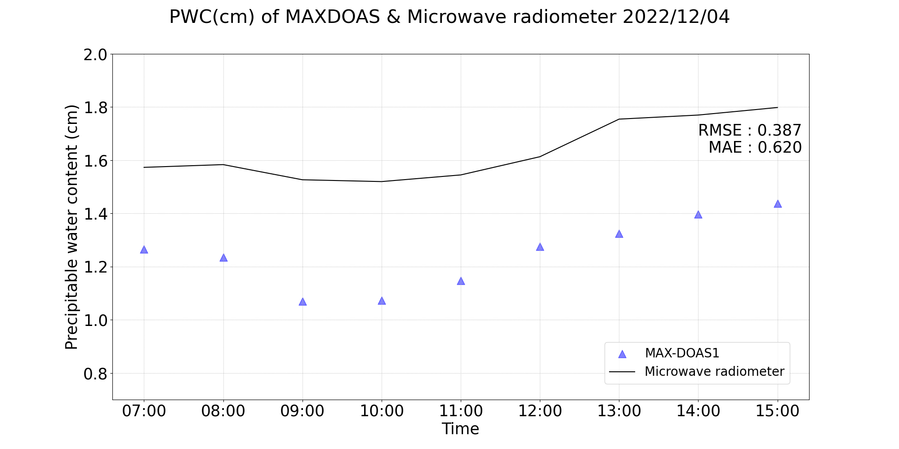
RMSE and MAE of PWC(cm)

Slide 8
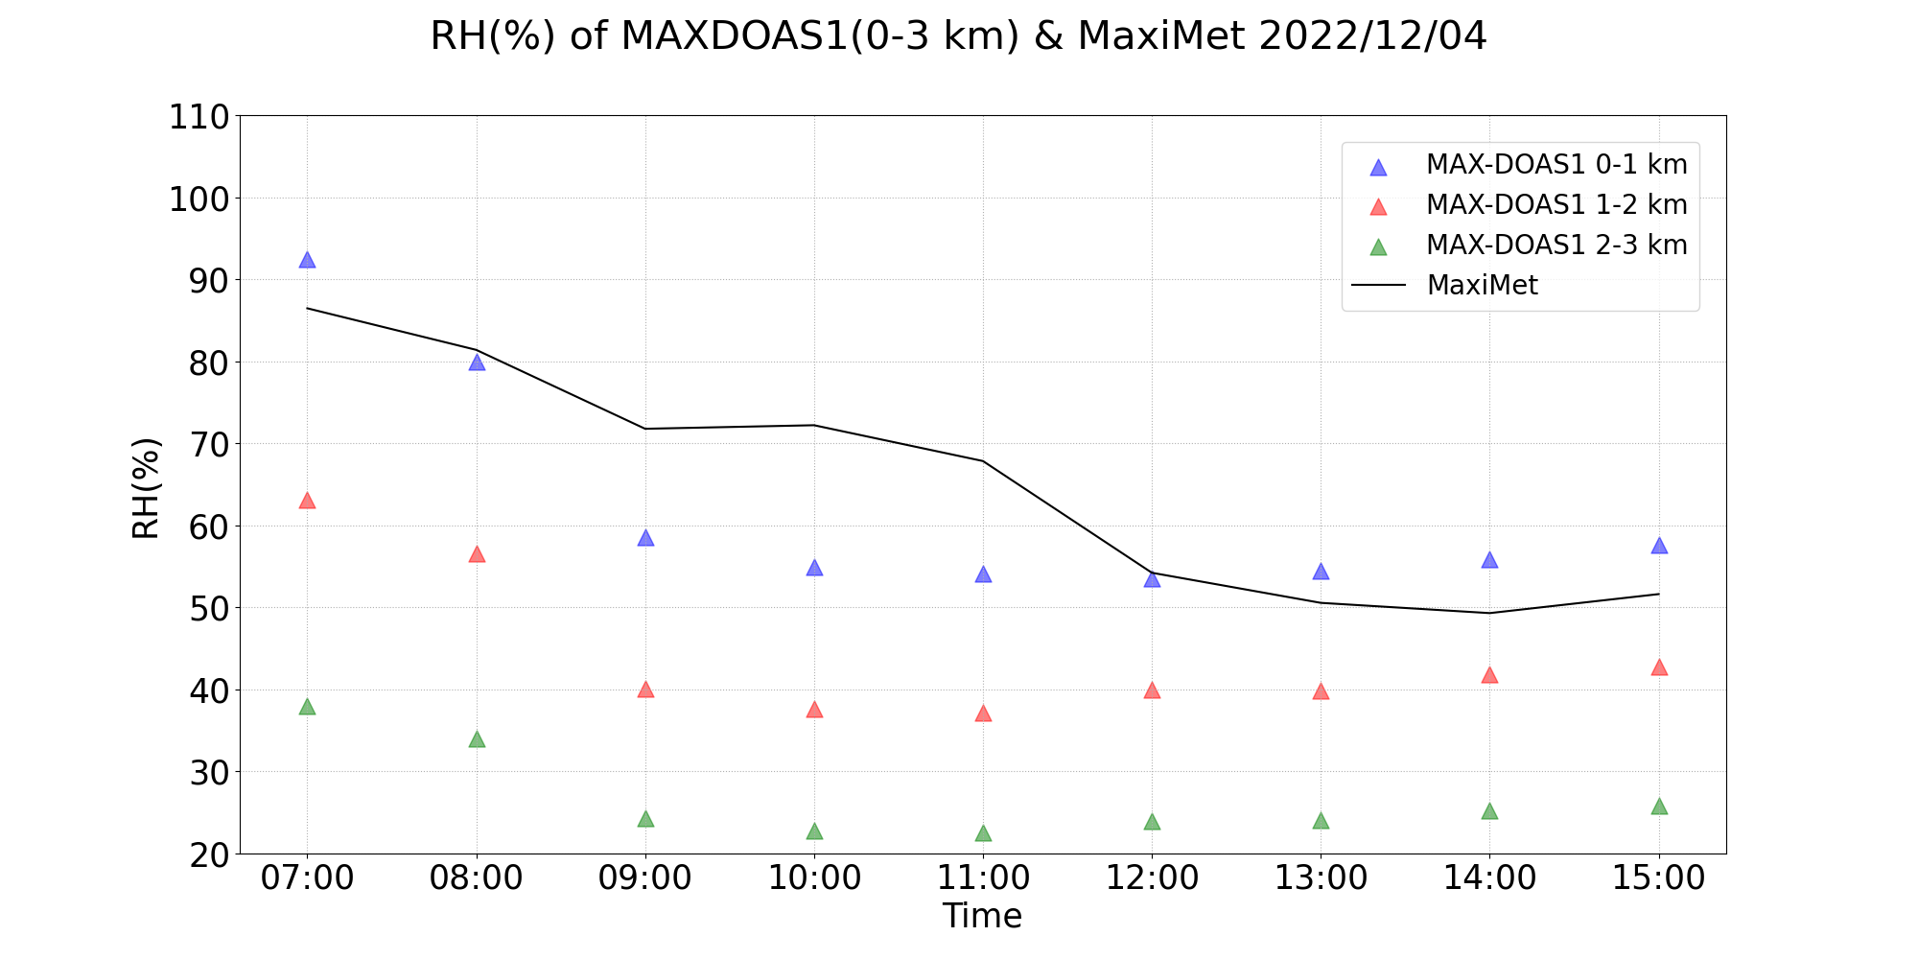
Comparison of RH between MAX-DOAS(0-3 km) and Maximet

